Slide 1

What is Middleware
Unit 1 INTRODUCTION
Ling ZHOU
School of Computer Science and Engineering
College of Software Engineering,
Southeast University, Nanjing
ling.zhou@seu.edu.cn

Slide 2

Middleware
A) Software
B) Hardware
C) Hybrid of software and hardware

Slide 3
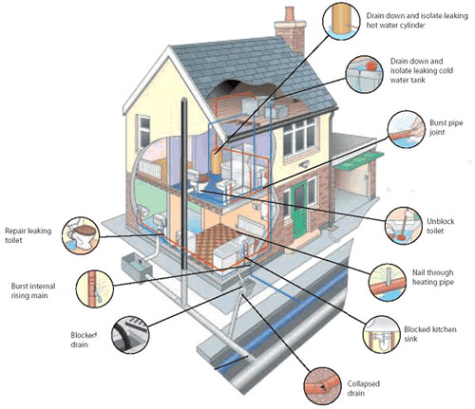
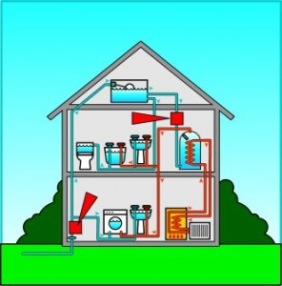
What is middleware?
Middleware is plumbing.
It may be mostly invisible, but it keeps things running

Slide 4
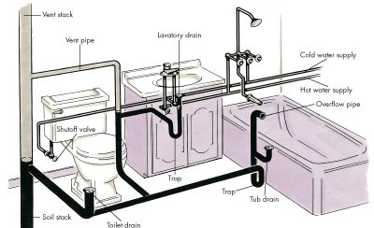
Middleware is mostly invisible.
Your view | House plumbing system | www
Do not see | the plumbing | middleware
See | the water | web sites and the information flow
This is part of why middleware is hard to define.
The middle part, that plumbing that ties everything (top and bottom levels) together, can seem less concrete and identifiable.
Submit a query via the web
Forward the query to the DB
Web Server
Middle-ware
Data-base
Present the data on the web
Deliver the data to the middleware

Slide 5




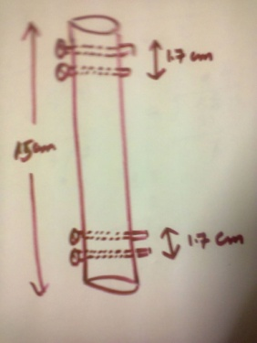



Standard Middleware Components (1)
Plumber
Build from scratch
Buy plumbing fixtures
Invent your own
Application Programming Interfaces (APIs)

Slide 6

Standard Middleware Components (2)
In middleware, these standards take the form of libraries of functions that your programs call through well-defined application programming interfaces (APIs).

Slide 7
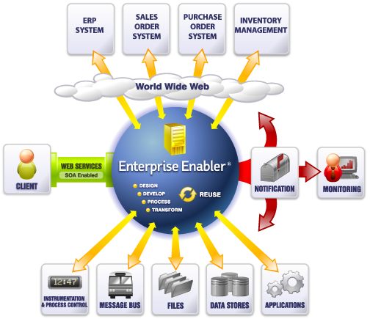
Middleware ties together parts of complex systems
Middleware keeps information moving through complex web-based applications.
Primary tasks is to connect systems, applications, and databases together in a secure and reliable way.
E-commerce: middleware tied together many different computers, each in a different location, all running the store’s e-commerce application, into a cluster.
Example?
Notes:
企业资源计划即 ERP (Enterprise Resource Planning)

Slide 8

What is middleware on earth?
Middleware is computer software that
connects software components and applications;
facilitates exchange of data between two application programs within the same environment, or across different hardware and network environments.
consists of a set of enabling services that allow multiple processes running on one or more machines to interact across a network.
provides for interoperability in support of the move to coherent distributed architectures.

Slide 9
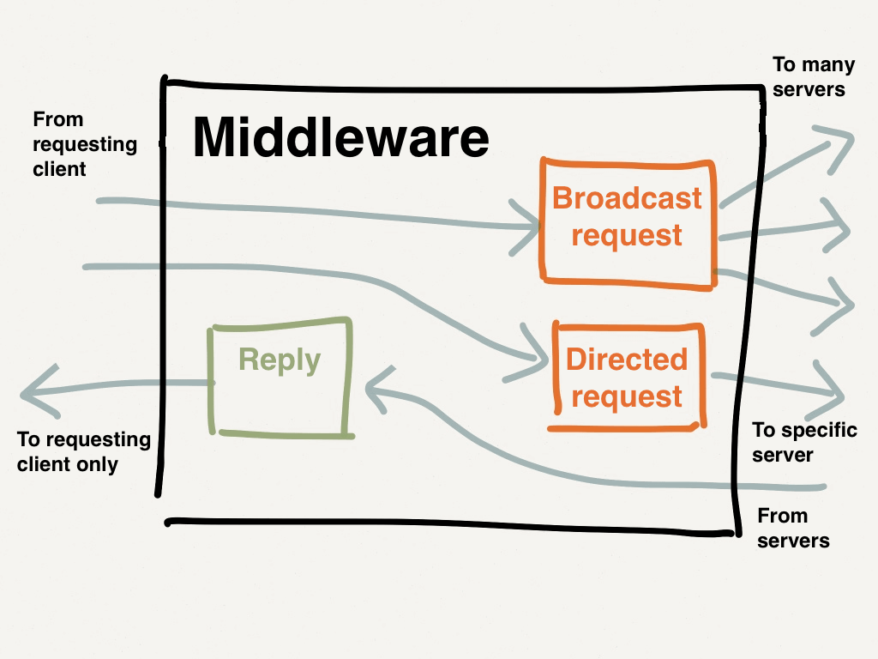
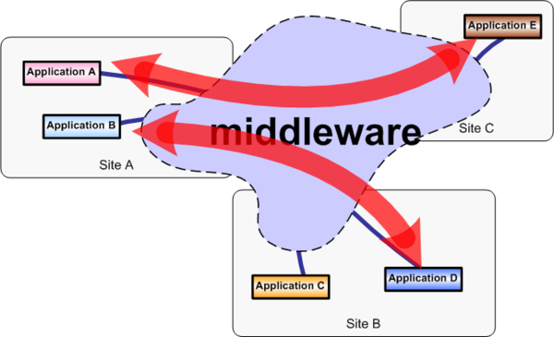
Middleware – Vague Definition
Any software program that functions as a link between two other programs, such as a Web server and a database program.
But middleware functionality is often incorporated in application or network software, so precise definitions can get all messy. Avoid using at all costs…

Slide 10
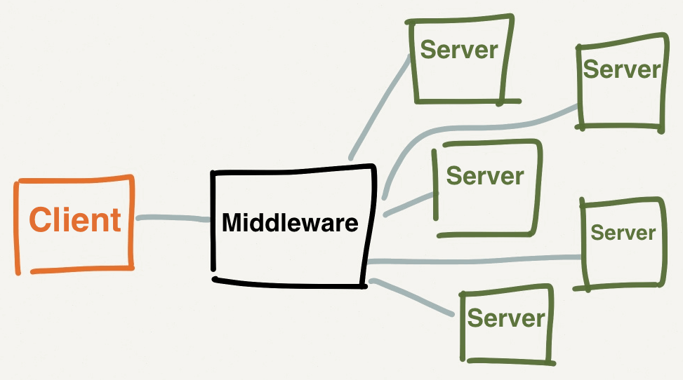
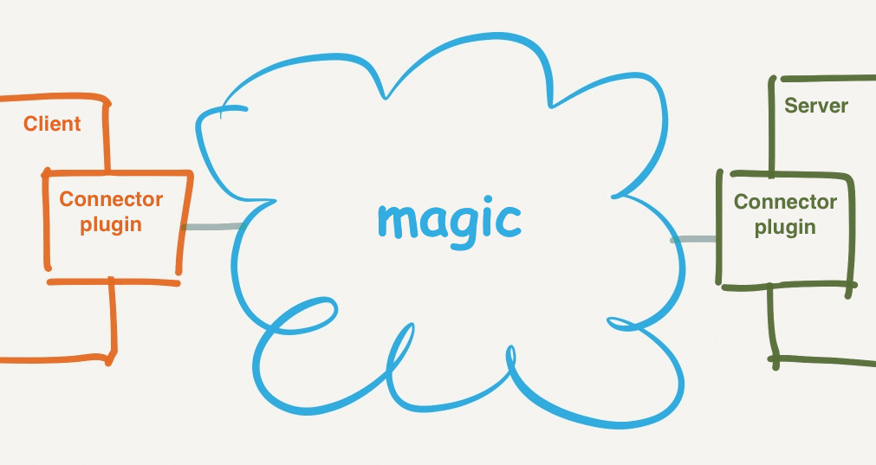
Types and categories of middleware
Three basic types of middleware:
Communication middleware
Database middleware
System middleware
Common middleware categories include:
ESBs (Enterprise Service Bus)
TP monitors
DCE (Distributed Computing Environment)
RPC systems
Object Request Brokers (ORBs)
Database access systems
Message Passing
http://docs.puppetlabs.com/mcollective/overview_components.html

Slide 11
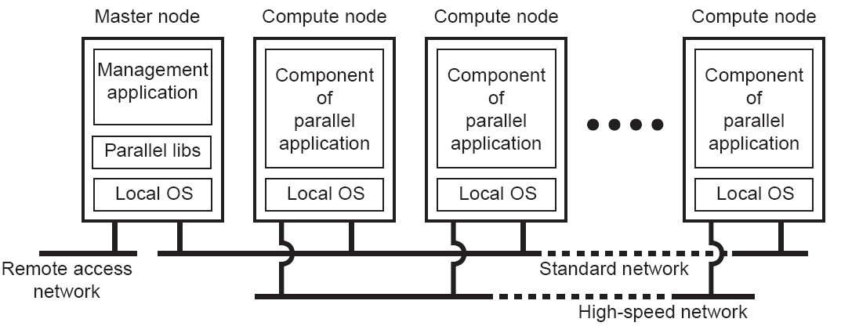
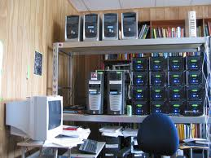
Cluster Computing Systems
Middleware
Cluster building a super-computer becomes financially and technically attractive

Slide 12
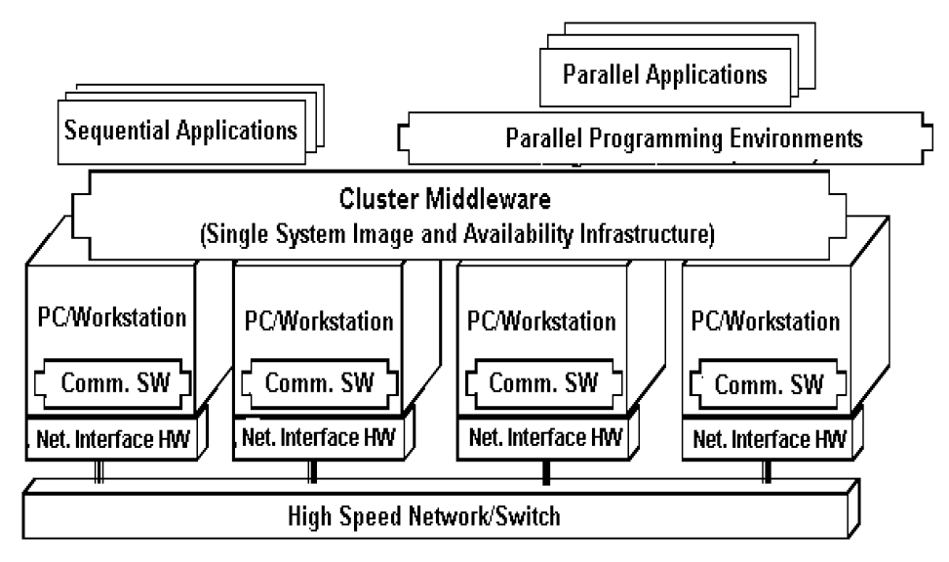
Computer 1
Computer 2
Computer 3
Computer 4
Appl. A
Appl. B
Appl. C
Distributed system layer (middleware)
Local OS 1
Local OS 2
Local OS 3
Local OS 4

